Slide 1




BRAIN TUMOR DETECTION​
Mentor - Dr. Trilok Chand
Karan Dhar (20103001)​
Adil Vinayak (20103034​)
Ankit Rupal (20103035)​
Lalit Kumar (20103051)

Slide 2
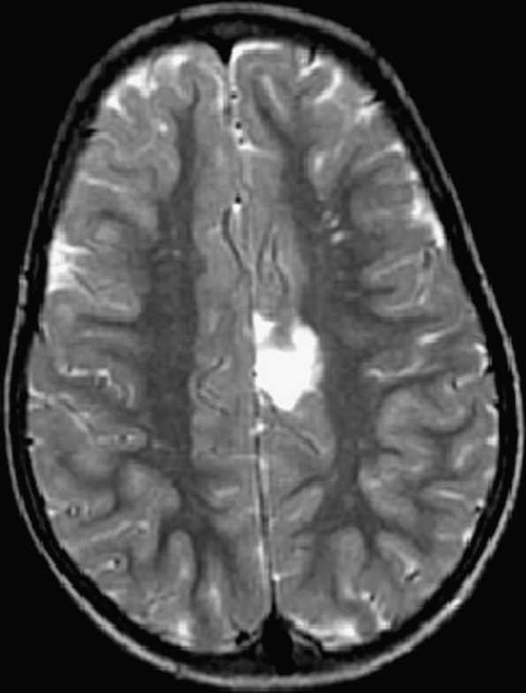
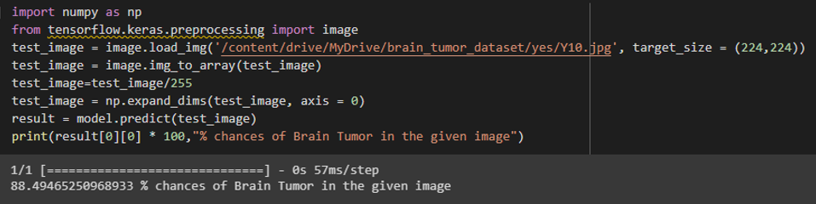
PREVIOUS PROGRESS
Convolutional neural network model built using MobileNetv2 with an average accuracy of 85-90%. ​

Slide 3


FRONT END
The Website interface is designed using the Streamlit framework of python.
Streamlit is an open-source app framework for Machine Learning and Data Science
Streamlit

Slide 4

DEPLOYMENT
The Website is deployed using the ngrok.
Ngrok helped us to create and debug your localhost project on a secure HTTPS.
Ngrok

Slide 5
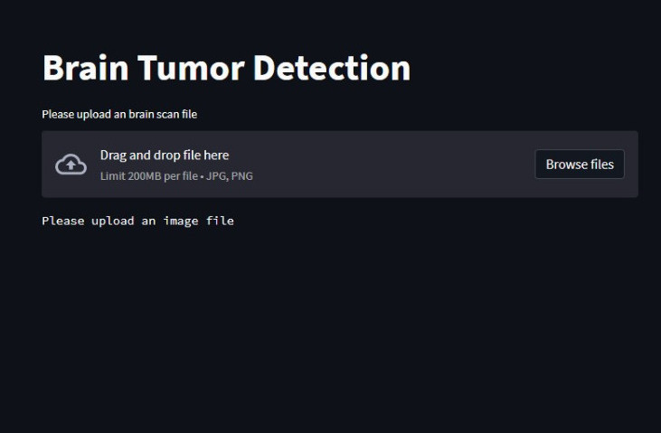
RESULTS INFERENCE
For the given brain MRI, our website predicts whether the brain is defected with tumor or not!
Prediction occurs as:
CLASS 1 : Low Chances (0% - 20%)
CLASS 2 : Moderate Chances (21% -75%)
CLASS 3 : High Chances (76% - 100%)
The model's accuracy is above 95%.

Slide 6
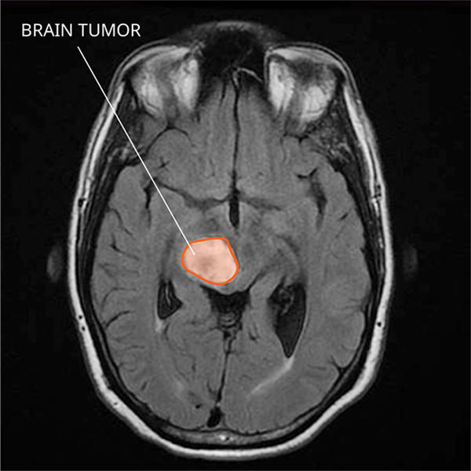
CONCLUSION AND FUTURE WORK
The model predicts with an accuracy above 95% and with an f1 score of .
FUTURE WORK: We have found a new data set on Figshare!
This dataset is numerous and accurate.
In future, we will use this dataset on our
model with more number of epochs to
increase the overall reliability of the
prediction of the tumor cells.

Slide 7
References
[J. C. Buckner, P. D. Brown, B. P. O’Neill, F. B. Meyer , C. J. Wetmore,J. H Uhm, "Central nervous system tumors." In Mayo Clinic Proceedings,Vol. 82, No. 10, pp. 12711286, October 2007.
R.Kumari,“SVMclassificationanapproachondetectingabnormalityinbrainMRIimages,”InternationalJournalofEngineeringResearchandApplications,vol.3,pp.1686–1690,2013.
[6]J. C. Buckner, P. D. Brown, B. P. O’Neill, F. B. Meyer , C. J. Wetmore,J. H Uhm,"Central nervous system tumors." In Mayo Clinic Proceedings,Vol. 82, No. 10, pp. 12711286, October 2007.
.​

Slide 8


